Slide 1
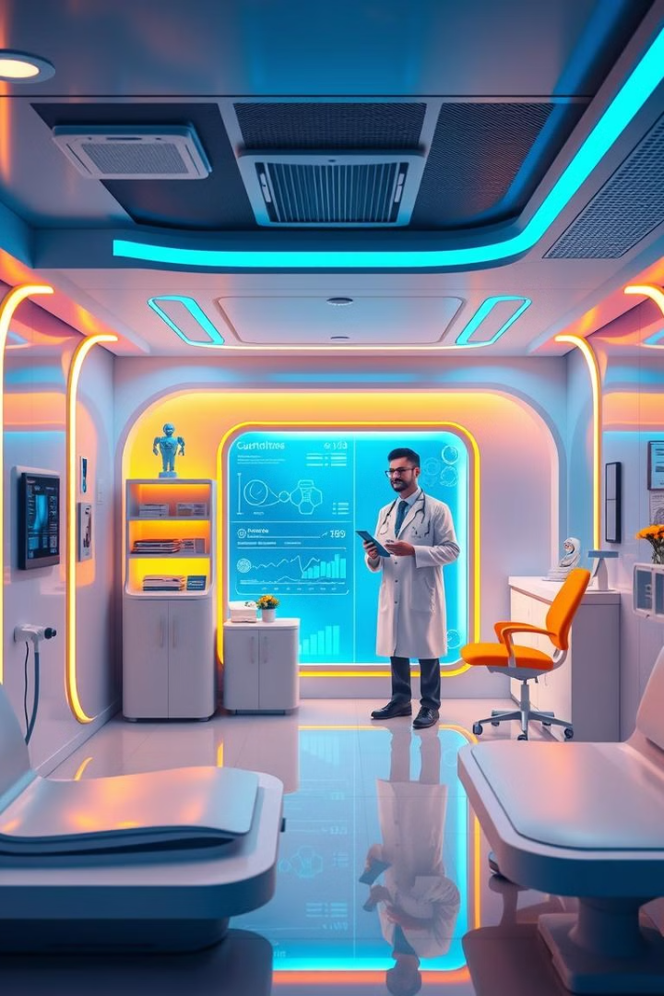
AI-Based Disease Prediction System
A Smart Medical Suggestion & Diagnosis Tool
ro
by roy ox

Slide 2




Introduction: Predicting Diseases with Machine Learning
Our system predicts diseases using machine learning. Users input their symptoms. The system then provides recommended medications. It also suggests precautions. It helps users get preliminary health advice.
Data Input
Prediction
Health Advice
Users input symptoms
Disease prediction
Preliminary guidance

Slide 3
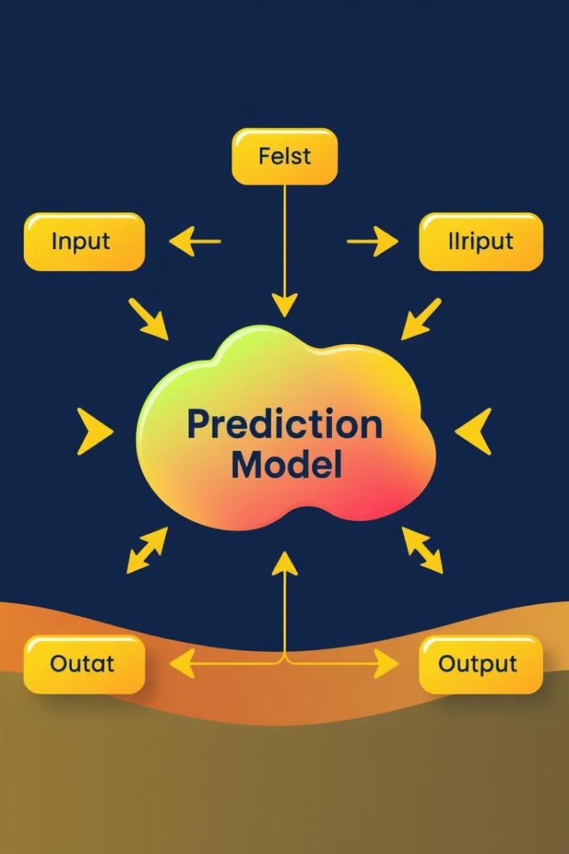



System Architecture: Data Input, Prediction Model, and Output
The system architecture has three components. First, data input. Second, the prediction model. Third, the output display.
Data Input
User enters symptoms.
Prediction Model
Machine learning core.
Output
Display results.

Slide 4

Feature Engineering: Selecting and Preprocessing Symptoms
Feature engineering is a critical step. It involves selecting relevant symptoms. It also includes preprocessing the data for use in the model. This ensures data is high quality.
1
Symptom Selection
2
Data Cleaning
Choosing relevant features.
Removing noise and errors.
3
Transformation
Formatting data for the model.

Slide 5
Machine Learning Models: Comparison and Selection
Various machine learning models were evaluated. These models were compared for their performance. The best model was selected for the system based on accuracy.
Logistic Regression
Random Forest
Neural Networks
Simple, interpretable model.
Ensemble of decision trees.
Deep learning approach.

Slide 6
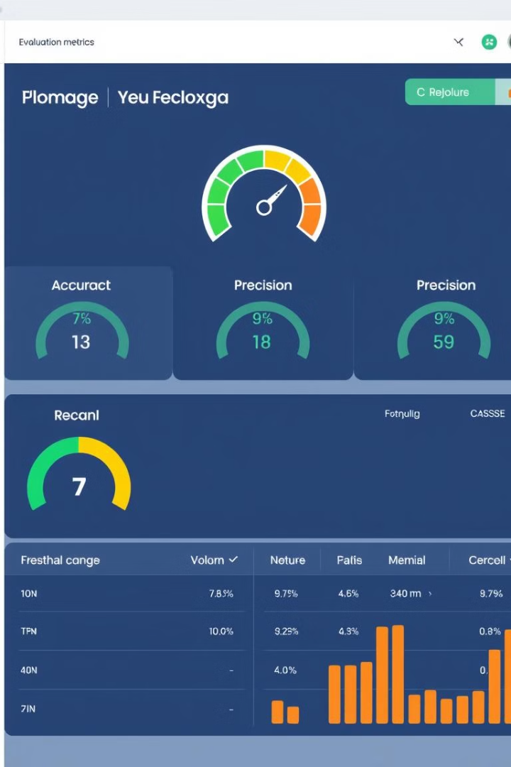
Evaluation Metrics: Accuracy, Precision, and Recall
The system was evaluated using key metrics. Accuracy measures overall correctness. Precision indicates the relevance of results. Recall measures the ability to find all relevant cases.
95%
92%
Accuracy
Precision
Overall correctness.
Relevance of results.
90%
Recall
Completeness of results.

Slide 7
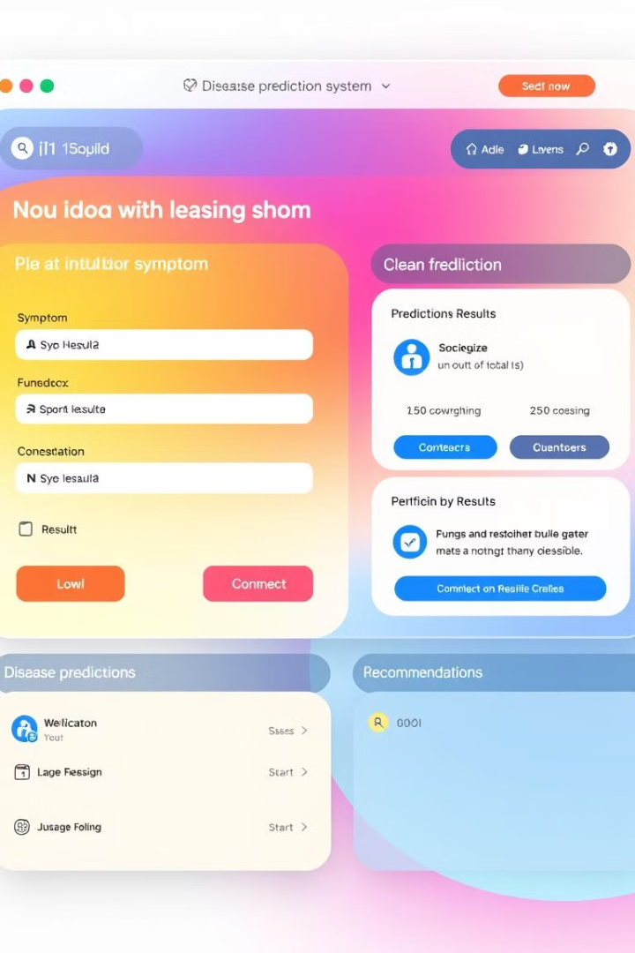
User Interface: Design and Functionality
The user interface is designed for ease of use. It allows users to input symptoms. It clearly displays the predicted disease. It shows recommended medications and precautions.
Input
Prediction
Symptom entry.
Disease display.
Recommendations
Medications and precautions.

Slide 8
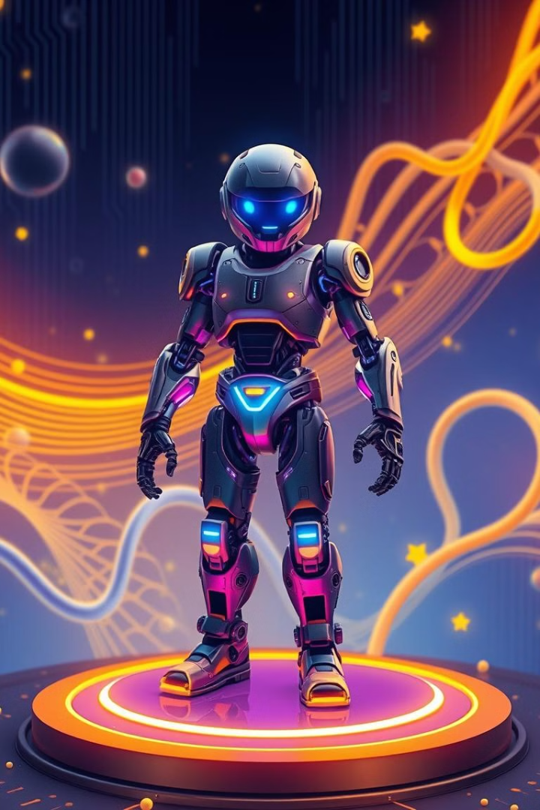
Future Enhancements and Conclusion
Future enhancements include expanding the database. Also, adding more sophisticated models. The goal is to provide more accurate and personalized predictions. The system offers valuable preliminary health advice.
1
Database Expansion
Adding more diseases.
2
Advanced Models
Improving prediction accuracy.
3
Personalization
Tailoring advice.

Slide 9
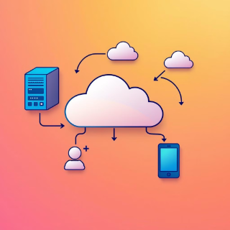
Deployment and Future Scope
1
Current Deployment
2
Deep Learning
3
Voice Integration
Deployed on Streamlit Cloud. Accessible and scalable solution.
Enhance model accuracy. Use advanced deep learning techniques.
Enable voice-based input. Hands-free symptom entry option.
4
Doctor Integration
Real-time consultations. Connect with doctors.

Slide 10
Technologies Used
Python
Joblib (Model Deployment)
Streamlit (Frontend)
Scikit-learn (Machine Learning)
Pandas, NumPy (Data Handling)
Streamlit Cloud

